Slide 1

DRAIN: Deadlock Removal for Arbitrary Irregular Networks
http://synergy.ece.gatech.edu
Mayank Parasar, Hossein Farrokhbakht, Natalie Enright Jerger, Paul V. Gratz, Tushar Krishna, Joshua San Miguel
mparasar3@gatech.edu
Notes:
Good morning!
I am Mayank Parasar from Georgia Tech. Today I will talk about a novel technique called DRAIN, which provides deadlock freedom in any network topology by periodically moving packets in the network.

Slide 2
Challenge I: Routing Deadlock
Deadlock: Cyclic dependence between packets
Renders the forward progress of packets impossible
Correctness problem, can cause system failure
Network
6
9
10
5
Network
Deadlock
Network
5
6
10
9
Destination Router-5
Network
5
Notes:
One of the fundamental problem each network must solve is that of deadlock.
Let me show how deadlocks can be manifested in the on-chip network.
this is an arbitrary network topology and we are focusing on these 4 routers where I will show the deadlock using animations.
Packets move in the network to reach their destination and the path is guided by the routing algorithm used in the network.
Packet can only move forward if there is free buffer present at the next hop router in their path towards destination.
Here num on the packet represent the destination router that packet wants to reach.
In doing so they may incur in cyclic dependency as shown here packet 5 cannot move down because the buffer is occupied by packet 6. Packet 6 cannot move right because the buffer is occupied by packet 10 and so on and so forth. This dependency comes back to packet 5. This cyclic dependency leads t a deadlock.
Rendering the forward movement of packet impossible,
And it is a correctness problem which can cause complete system failure.

Slide 3

Challenge II: Protocol Deadlock
Interconnection Network
Finite Network Buffers
Incoming Queue
Outgoing Queue
Interconnection Network can be visualized as queues of buffers transporting packets
Notes:
Second challenge is that of a protocol level deadlock.
To understand protocol level deadlock consider interconnection network to facilitate the movement of packets between nodes.
At a higher level, interconnection network can be considered as queues buffers for transporting packets from their source to destination

Slide 4
Challenge II: Protocol Deadlock
Cache
Cache
Injection queue
Dedicated Ejection queue
Dedicated queue (aka Virtual Network)
Request Packet
Finite Network Buffers
Response Packet
Directory
Directory
No virtual Network
Separate Virtual Network
Buffers occupied by the request packets, renders forward movement of response packet impossible
Notes:
There can be different types of packets flowing in the network. If all types of packet share the same queue then
Higher priority packets may get blocked by lower priority packets as shown in the figure. (resulting in priority inversion)
Here there is no cyclic dependency, but all the buffers of the network are exhausted by the request packet. This blocks the response packets forever to make forward progress. Response packet needs to reach to its destination for making forward progress of the whole system. This results in protocol level deadlock.
To resolve protocol deadlock separate queue for each message type is allocated, so that packets of one message type do not take up the buffers of other message types. These are called Virtual Network

Slide 5
Deadlocks are rare!
Number of links removed ➔
0
1
2
4
8
16
20
24
1-vc
blackscholes
4-vc
1-vc
bodytrack
4-vc
canneal
1-vc
4-vc
1-vc
fluidanimate
4-vc
swaptions
1-vc
4-vc
0%
20%
40%
60%
80%
100%
Deadlock Probability
Requires certain ensemble of packets with a particular buffer dependency for the deadlock to occur
Notes:
To quantify the likelihood of routing deadlocks in real application we performed the following experiments
With router configuration of 1-vc and 4-vc per virtual network
We took 8x8 Mesh and progressively removed links to see the likelihood of routing deadlock.
We did not observe the routing level deadlock where there were few faults,
Only when the topology becomes fragmented by removing more number of links do we actually start observing the deadlocks.
This shows that deadlocks are rare, yet it is the correctness issue and must be resolved for the functioning of the network.

Slide 6
Prior Work-Routing Deadlock
Dally’s theory
Strict order in acquisition of links/buffer
XY, West-First, Up*/Down*
Duato’s theory
Acyclic extended CDG
Escape VC
Flow Control based schemes
Restrict injection to avoid deadlock
Bubble Flow Control
Deadlock Recovery
Detect and recover from deadlock
DISHA, Static Bubble, SPIN
Notes:
Currently proposed solutions
Earlier Solutions proposed to resolve routing deadlock can be categorized in following categories:
1. Dally's theory:
make CDG acyclic using routing algorithm, by disallowing certain turns
examples are XY routing, West First routing etc
2. Duato's theory
Allows more path diversity
tries to make the extended CDG to acyclic and proves that as long as there is a path which is acyclic then network is deadlock free
examples are escape VC
3. There are flow control techniques:
which controls the injection of packets in the network such that deadlock cycle never forms.
examples are Bubble Flow Control
4. Deadlock recovery schemes argue that deadlock avoidance allocate excessive hardware just to prevent deadlocks to occur..instead we should detect deadlock and recover from it.
Examples are Disha., static bubble and spin

Slide 7
Prior Work-Protocol Deadlock
Separate set of VCs (called as Virtual Network) for each message class at each input port
Avoiding message-dependent deadlock in network-based systems on chip
Exclusive Bubble for each Virtual Network
Bubble coloring: Avoiding routing and protocol-induced deadlocks with minimal virtual channel requirement using non-minimal routing
Deadlock Recovery using probes and extra buffers
mDisha: Reserves the buffer at network interface and in each router
Fork multiple token
Notes:
Solutions proposed to resolve protocol deadlock:
Separate VC for each message type (aka Virtual Network)
Avoiding message deadlock by having bubble for each message type. The underline theory is that if there is bubble in a ring then network is deadlock free. However this leads to non-minimal packet traversal
Deadlock recovery has been proposed to protocol deadlock too. It requires extra buffers and probes to detect and resolve protocol level deadlocks at runtime.

Slide 8
Classification: Taking a lookback
Proactive Techniques
Avoid deadlock to begin with
Reactive Techniques
Allows deadlock in the network
Detects deadlocks and recovers from deadlock
Notes:
We have classified the prior proposed techniques in following two categories:
Proactive Techniques: These techniques avoid the deadlock in the network to begin with
Reactive Techniques: These techniques allows the deadlock in the network. They detects the deadlock and then recovers from it.

Slide 9


Qualitative Comparison of Deadlock Freedom Mechanisms
Design | Type of Solution | High Performance | Low Area Power | Low Hardware Complexity | Routing Deadlock-free | Protocol Deadlock-free
Turn Restriction [1] | Proactive
Escape VC [2] | Proactive
Virtual Network [3] | Proactive
Deadlock Recovery [4] | Reactive
? | ??
[1]:
Deadlock-free message routing in multiprocessor interconnection networks [IEEE Trans. Computer, 1987]
Can we do better?
[2]:
A new theory of deadlock-free adaptive routing in wormhole networks. [IEEE Trans. On Parallel and Dist. Sys, 1993]
[3]:
The Alpha 21364 network architecture [MICRO 2002]
[4]:
DISHA [IPDPS’95] Static Bubble [HPCA’17] SPIN [ISCA’18]
Notes:
Deadlock is a well studied problem in interconnection networks, more than 4 decades of research has been done in this field. I am evaluating the previous proposed solutions on following metric
Weather the solution provides full path diversity?
If there are extra VCs used in the solution?
Is the solution works for a fixed topology?
Does the solution require expensive circuitry to detect and resolve deadlock?
--
Dally’s solution restricts certain turns that a packet can take in the network, so the packet is not involved in the deadlock, to begin with.
Because of turn restriction, a packet cannot utilize the full path diversity and it needs to know about the topology.
Duato’s theory proposes an acyclic escape path within the extended cyclic CDG of the network and every packet has access to this acyclic escape path to make the network deadlock-free. Acyclic escape path requires an extra set of buffers in the form of escape VC and escapeVC needs to know about the topology to make this escape path acyclic, and packet in the escape path cannot enjoy the full path diversity
Then there is work on restricting the injection of packets in the network such that deadlock never happens. This comes with an underlying theory that as long as there is a bubble or free VC present in the ring it will be deadlock-free.
This cannot provide full path diversity to the packet and this theory is tied to ring-like topology
Deflection routing keeps misrouting packets every cycle such that the packet never stays in the same buffer for more that one cycle. Because of which packet cannot utilize the full path diversity during congestion due to continued misrouting.
Then there is work on coordination, which detects and maps the deadlock during runtime using probes and timeouts and then synchronizes the movement of packets involved in the deadlock. This involves complicated deadlock detection circuitry.
As we can see there is no work which has all the favorable characteristics and we ask this question that can we come up with a technique which provides all these favorable characteristics

Slide 10

Classification: Taking a lookback
Proactive Techniques
Avoid deadlock to begin with
Reactive Techniques
Allows deadlock in the network
Detects deadlocks and recovers from deadlocks
Subactive Techniques
Allows deadlock in the network
Obliviously flushes network to remove any deadlock
Notes:
We introduce a new class of solutions called ”Subactive Techniques”
These techniques allows the deadlock in the network, but oblivious flushes the network to remove any deadlock which may be present.

Slide 11
Outline
Background: Deadlocks
Current Solutions
DRAIN
Walk-through
Concept
Deadlock freedom proof
Router microarch
Evaluations
Methodology
Results
Conclusion
Notes:
To that end let me introduce the concept of DRAIN

Slide 12
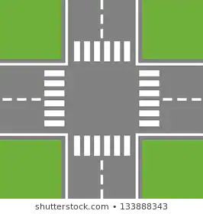



Traffic Deadlock
Oblivious Movement
Deadlock
Notes:
To understand DRAIN, let us consider the traffic deadlock as shown in the figure… Here each car is waiting on the next car to move in order to make forward progress, resulting in traffic deadlock.
If we provide oblivious periodic movement to all the cars in this road network, then this will flush out any deadlock as shown in the animation.
All cars are unblocked and will reach to their destination.
The same idea is used in DRAIN to resolve deadlock, if consider cars as packets and roads as the links in the network

Slide 13
Virtual ring over topology
0
1
2
5
6
3
4
5
0
3
4
7
6
7
8
1
2
Irregular
Mesh
Every link is spun exactly once, simultaneously
Oblivious packet movement over the virtual ring
Notes:
DRAIN forms a virtual ring over the topology.. As I am showing it for 3x3 Mesh. This is also applicable to other irregular topologies.
The virtual ring is formed such that each link is spun/covered only once, and all the links are covered. This makes sure that there is no collision of packets when spun over this virtual ring
Oblivious packet movement over this virtual ring makes sure that if there is any deadlock in the network, it is flushed out.

Slide 14
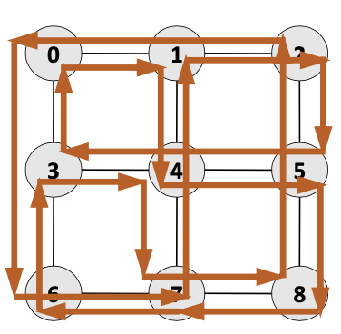
Key Terms
DRAIN forces all packets to take specific turn in the network
Drain Path: The virtual ring connecting all the input ports, over which packet travel during DRAIN
Pre-Drain: The small-time window which allows the packets traversing the links to be buffered
Epoch : The time between two Drains
Full DRAIN: Allows all packets to traverse the whole topology and eject out during traversal
Notes:
Before going into the actual implementation of DRAIN let me talk about key terms used in DRAIN

Slide 15
DRAIN to resolve Routing Deadlock
Pkt destination
DRAIN Path
Deadlock
Deadlock
Pkt Route
Irregular 3x3 Mesh topology
Notes:
This figure shows how DRAIN resolve routing deadlock in a irregular 3x3 Mesh.

Slide 16
DRAIN to resolve Protocol Deadlock
Response Pkt
Request Pkt
Irregular Mesh
Response Packet Blocked
Protocol Deadlock!
Response Packet is unblocked and reaches its destination
Notes:
This figure shows how DRAIN resolve protocol deadlock in same irregular 3x3 Mesh.

Slide 17
Outline
Background: Deadlocks
Current Solutions
DRAIN
Walk-through
Concept
Deadlock freedom proof
Router microarch
Evaluations
Methodology
Results
Conclusion
Notes:
Now let me rephrase the key idea about DRAIN

Slide 18
DRAIN: Concept
Periodically converts the topology into a ring
Moves all the packets on the ring for ‘k’-hops
After Drain, packets resume to follow the baseline routing
Resolves deadlock by allowing packets to be unblocked

Slide 19
DRAIN Control Path
When to begin Drain?
The ‘Epoch’ is a design time knob to the network designer
How may hops does a packet move during Drain?
Every packet moves 1 hop.
This can be changed to k-hops at design time
Notes:
Let me talk about the control path of DRAIN which deals with tuning the DRAIN network

Slide 20
Outline
Background: Deadlocks
Current Solutions
DRAIN
Walk-through
Concept
Deadlock freedom proof
Router microarch
Evaluations
Methodology
Results
Conclusion

Slide 21
DRAIN: Deadlock Freedom Proof
Routing Deadlock Freedom
Every packet in the network moves during Drain
This allows the packet stuck in the deadlock to get unblock
Protocol Deadlock Freedom
Periodic Drain ensures the response message gets unblock to reach their destination
Livelock Freedom
Full Drain makes sure that all the packets get the chance to visit each router in the network, and eject out, if possible.

Slide 22
Outline
Background: Deadlocks
Current Solutions
DRAIN
Walk-through
Concept
Deadlock freedom proof
Router microarch
Evaluations
Methodology
Results
Conclusion

Slide 23
DRAIN: Router microarchitecture
Turn-Table
Epoch register
Credit freeze
Full-Drain Counter
DRAIN is completely decentralized and requires relatively low hardware overhead
Notes:
I encourage to read the paper.. I can answer more details

Slide 24
Outline
Background: Deadlocks
Current Solutions
DRAIN
Concept
Walk-through
Deadlock freedom proof
Router microarch
Evaluations
Methodology
Results
Conclusion

Slide 25
Evaluations
Gem5 for full system and SE mode simulations
Garnet2.0 for network simulation
DRAIN uses minimal random routing algorithm
VCT flow control
Evaluated on regular and irregular topologies
Derived from regular topologies by removing link

Slide 26
Outline
Background: Deadlocks
Current Solutions
DRAIN
Concept
Definition
Walk-through
Deadlock freedom proof
Router microarch
Evaluations
Methodology
Results
Conclusion

Slide 27
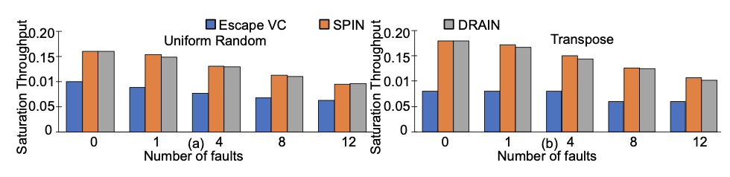
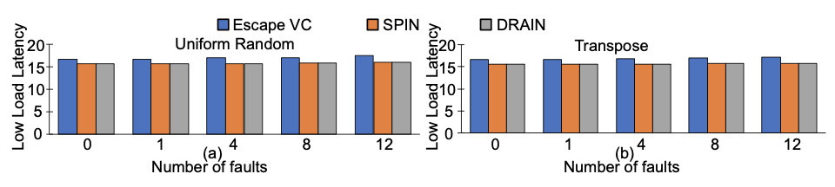
Synthetic Traffic
As Number of faults increases the saturation throughput decreases
Escape VC uses up-down routing (non-minimal) in the escape VC
DRAIN uses minimal routing and perform similar to SPIN

Slide 28
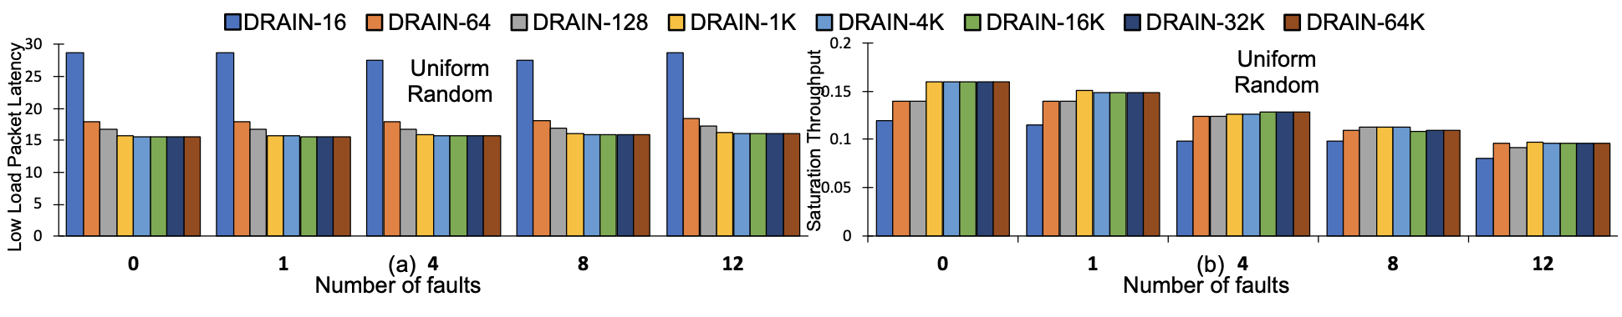
DRAIN Epoch Sensitivity
More misrouting at a lower Epoch period
Low saturation and high low-load latency
Performance decreases as faults increases because of less path diversity

Slide 29
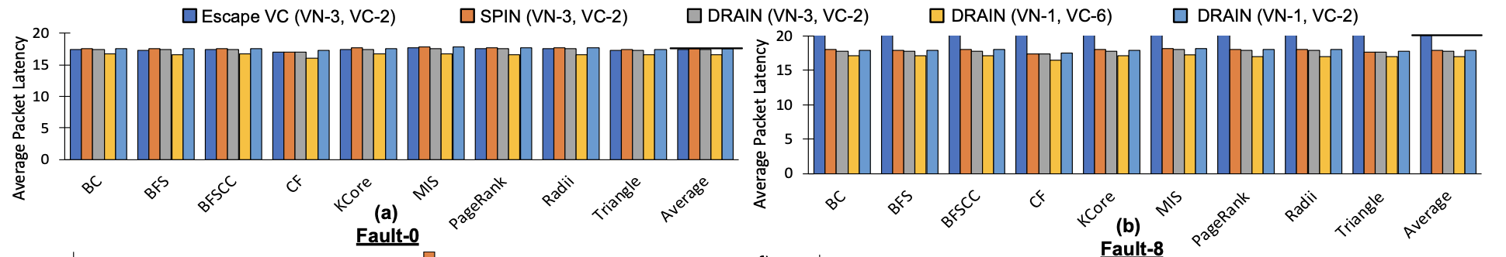
Real Application Results
Average Packet Latency (MESI Coherence Protocol)
8x8 Mesh with Fault-0 and Fault-8
15% average packet latency reduction, similar performance

Slide 30
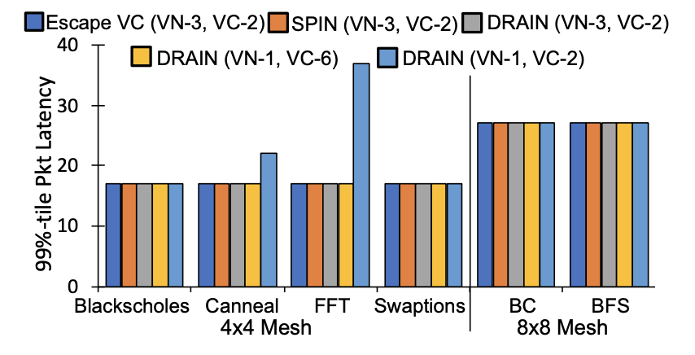
99%-tile Packet Latency
99%-tile packet latency graph for real application
Only in few cases DRAIN (VN-1, VC-2) shows higher latency
Notes:
Define 99%-tile packet latency
DRAIN appears to misroute packets and a deadlock could persist longer , so we studied
Delay in resolving the deadlock
This is tail latency graph

Slide 31
Router Area & Power
72% reduction in Area compared to baseline
77% reduction in Power compared to baseline

Slide 32
Outline
Background: Deadlocks
Current Solutions
DRAIN
Concept
Walk-through
Deadlock freedom proof
Router microarch
Evaluations
Methodology
Results
Conclusion

Slide 33
Classification: Taking a lookback
Proactive Techniques
Avoid deadlock to begin with
Reactive Techniques
Allows deadlock in the network
Detects deadlocks and recovers from deadlock
DRAIN: Subactive Techniques
Allows deadlock in the network
Obliviously flushes network to remove any deadlocks

Slide 34
Revisiting Qualitative Comparison
Design | Type of Solution | High Performance | Low Area Power | Low Hardware Complexity | Routing Deadlock-free | Protocol Deadlock-free
Turn Restriction | Proactive
Escape VC | Proactive
Virtual Network | Proactive
Deadlock Recovery | Reactive
DRAIN | Subactive
DRAIN [HPCA’20]
DRAIN is completely decentralized
DRAIN has low hardware overhead over baseline router
DRAIN obliviously provides deadlock freedom

Slide 35
Conclusion
Questions?
Codebase available here:
git@github.com:georgia-tech-synergy-lab/gem5_drain.git
Deadlock is the problem which every network must solve
Current solutions either require complex deadlock detection or provision extra set of buffers or restrict turns
DRAIN provides a novel way of resolving deadlock by periodically moving packets for few hops along a ring constructed over the network.
No extra buffer needed
Free from complicated deadlock detection circuitry
Provides full path-diversity therefore high performant
Thank you!

